Slide 1
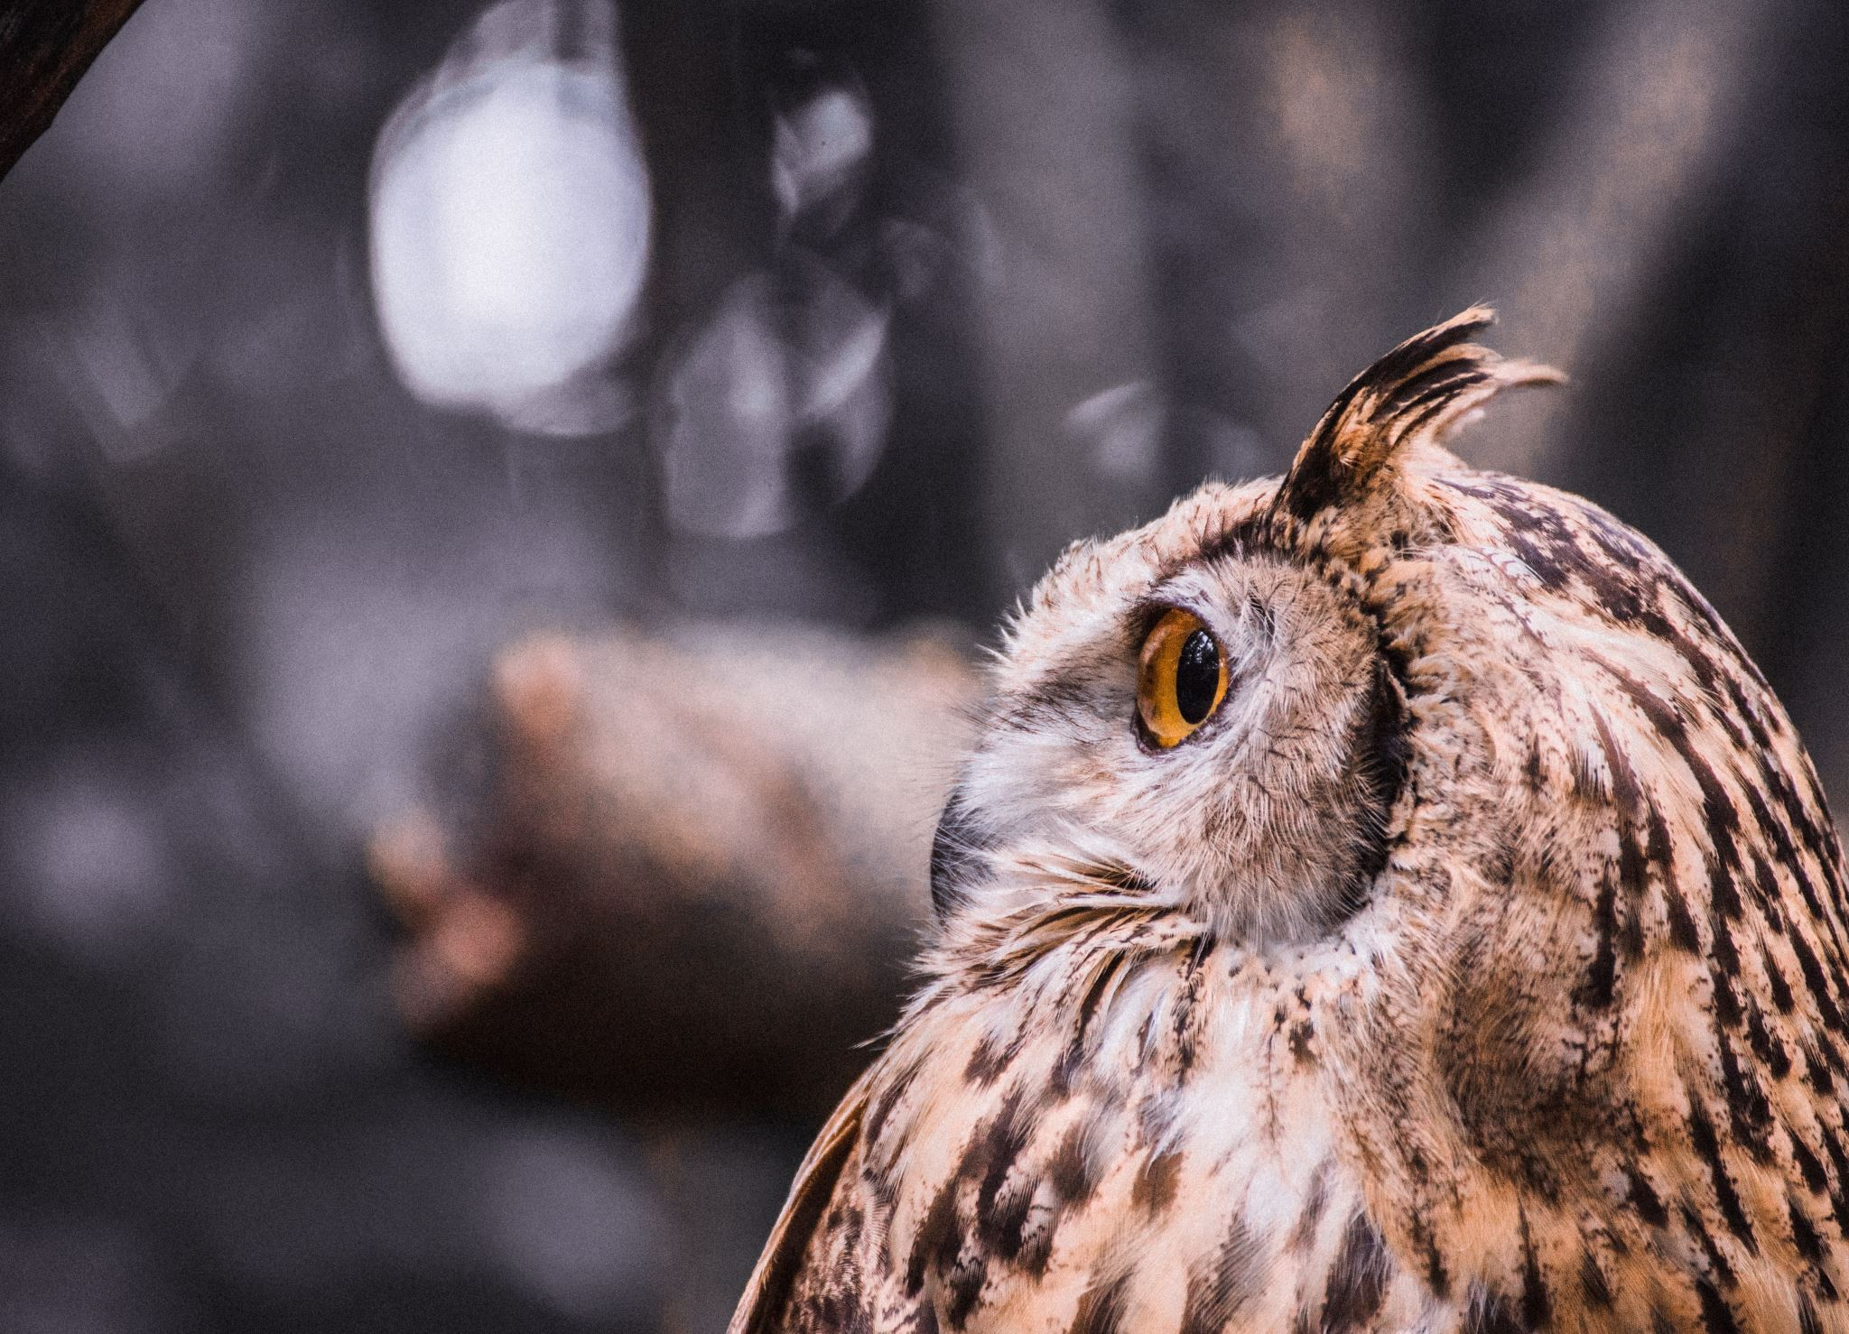
Welcome to Owl Class!
Years Five and Six

Slide 2
What are the Aston Rowant values?
Our aims :
Growing together, rooted in God, Fullness of Life, Colossians 2:7
‘Let your roots grow down into him, and let your lives be built on him’ Colossians 2:7
G GRATITUDE
R RESILIENCE
O OUTREACH
W WONDER
T TRUST
H HARMONY

Slide 3
The structure of the day.
Mornings are focussed on learning English and Maths and the afternoons are used for the rest of the curriculum subjects which are usually linked to our termly topic.
We have handwriting sessions twice a week, as well as free reading time (E.R.I.C, or ‘Everyone Reading In Class’). They also have the opportunity to read independently in class as part of the Guided Reading carousel.
PE is on a Tuesday and Thursday afternoon. Your child will need to bring a pair of trainers and spare socks as well as the Aston Rowant black jumper and red t-shirt. PE kit must come in on Monday and can come home Friday.
The full timetable for Autumn Winter term can be downloaded from the website, but here is a quick glimpse:

Slide 4
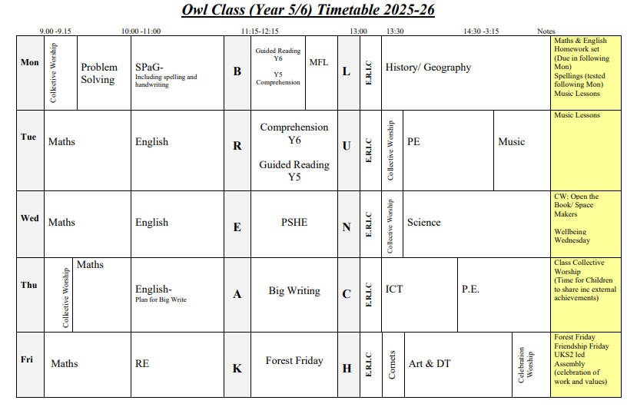
Weekly timetable for autumn term.

Slide 5
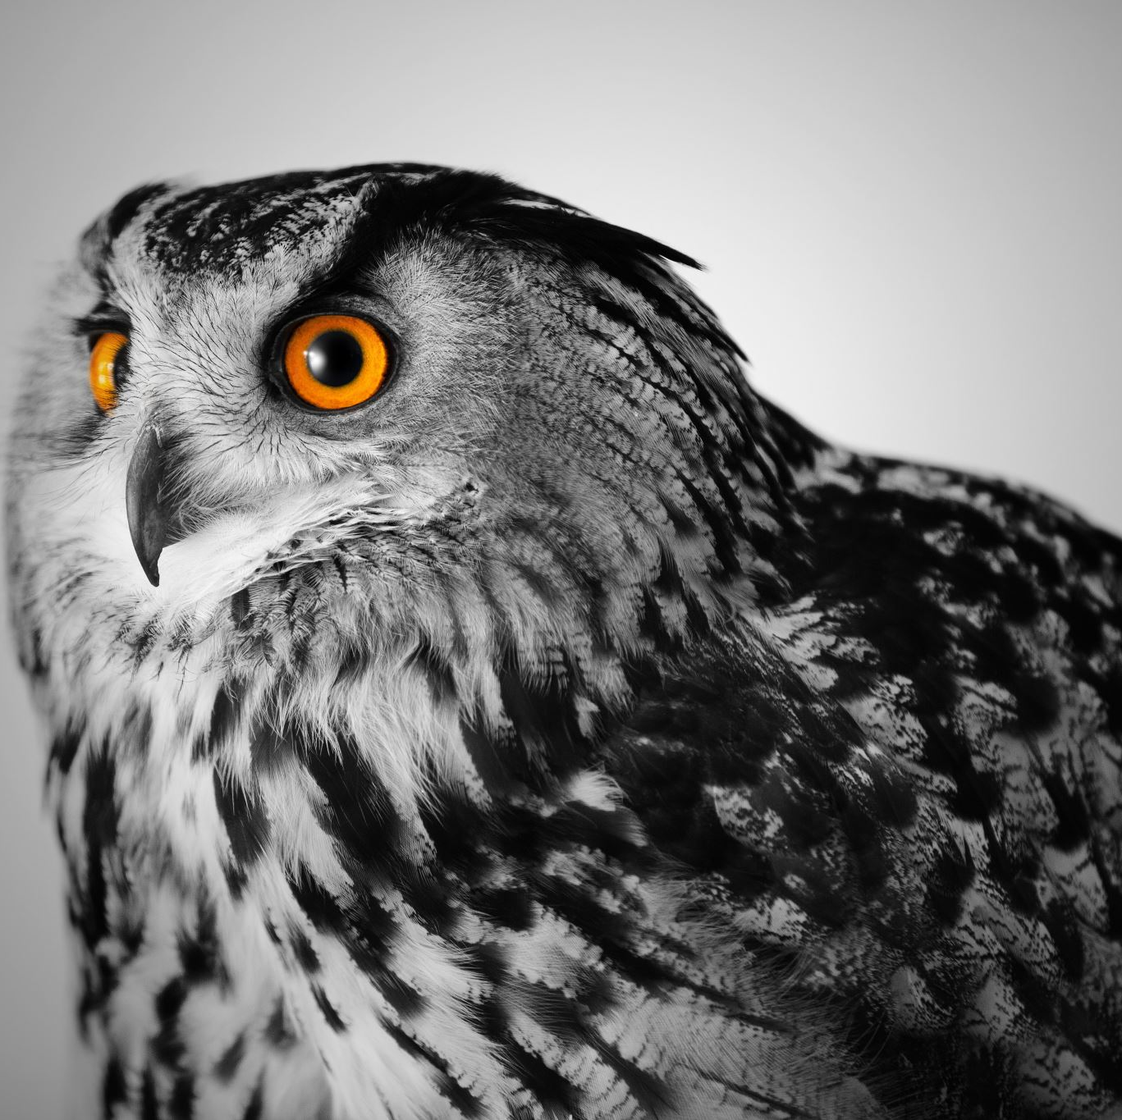
More about Owl Class-teaching and homework
Owl Class is taught by Mr Manning Monday to Friday, with support across the week from Mrs Smith.
Homework is set on Doodle Learing each Monday and is due back the following Monday. It will include SPaG work, maths work and there will also be an independent ‘big’ task each half-term, related to our central topic. Spellings can be found on the class page.
Independent research is a vital skill for KS3. It also gives the children the opportunity to conduct and present their work in creative ways, again preparing for secondary school.

Slide 6

Our reading for pleasure programme
A love for reading one of the best gifts we can give our child, and to help foster a love for reading, we have complied a list of 40 recommended reads for each year group, which can be found on the Owl Class page. These titles are readily available at libraries and should be easily found.
Owl Class will receive a Reading Log to add to as they read. This comes home daily, so please do hear your child read or read to them if you have the chance, and let us know in the comment section.

Slide 7
School trips
Trips this year will include a trip to Ufton Court as part of our topic on Vikings, plus visits from Oxford University Earth Sciences department, Opera First, and a visit to a solar farm in Summer term. Details for each will come out as soon as possible.

Slide 8
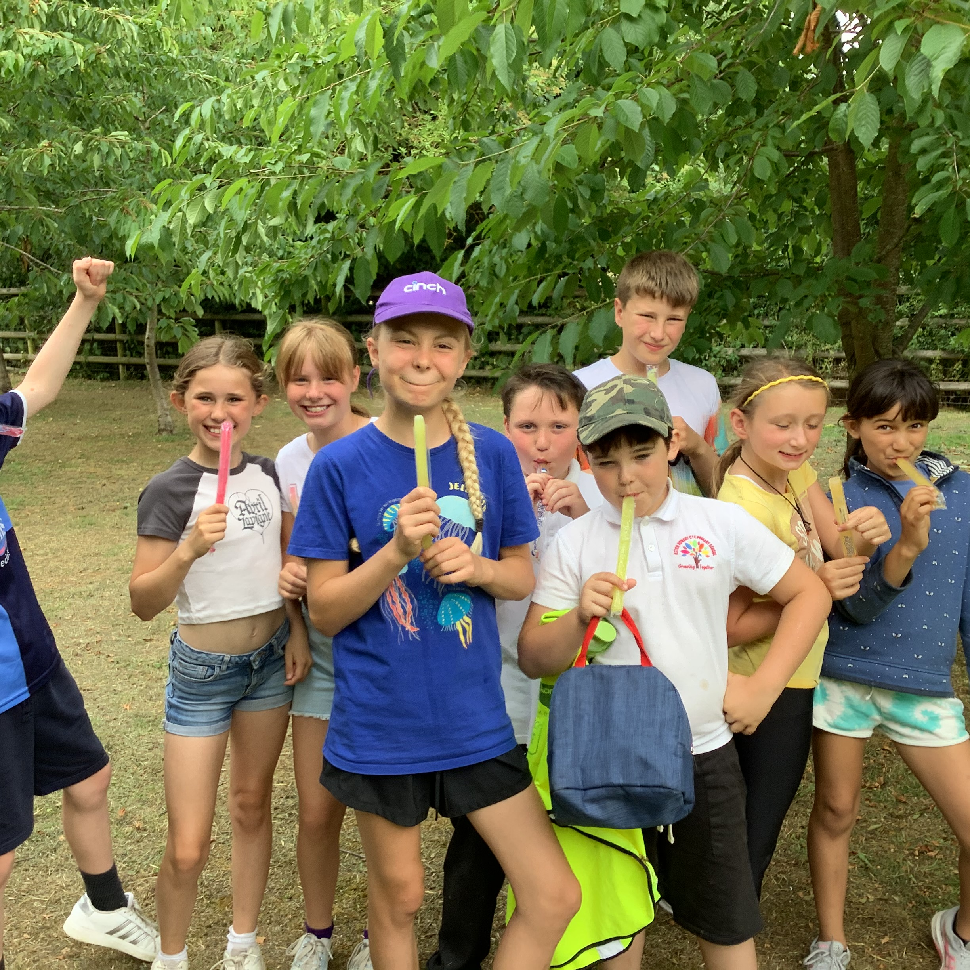
Residential Trip for 2025/26
There will be more details such as dates to follow soon.

Slide 9

SATs and assessment
This year the SATs for Year Six will begin on Monday 11th of May, and finish on Thursday the 14th May.
Monday will be the SPaG paper and spelling test.
Tuesday will be the Reading paper.
Wednesday will be the first Maths paper.
Thursday will be the last two Maths papers.
Year Six will begin practise this term with a full set of papers, so that we can take a baseline assessment.
Year Five have their own specialised revision programme and practice papers tailored to their curriculum needs.

Slide 10
If you have any questions…
You can email the school office at any time to let me know, this is the best way to inform me of absences or calander commitments
You can always catch me at the gate if you just want to let me know how your child is feeling, or if I should be aware of something that might affect their day.

