Slide 1
Welcome to Owl Class!
Years Five and Six

Slide 2
What are the Aston Rowant values?
Our aim :Growing together we can inspire each other to achieve our full potential as courageous, lifelong learners.
‘Let your roots grow down into him, and let your lives be built on him’ Colossians 2:7
G GRATITUDE
R RESILIENCE
O OUTREACH
W WONDER
T TRUST
H HARMONY

Slide 3
The structure of the day.
Mornings are focussed on learning English and Maths and the afternoons are used for the rest of the curriculum subjects which are usually linked to our termly topic.
We have handwriting sessions twice a week, as well as free reading time (E.R.I.C, or ‘Everyone Reading In Class’). They also have the opportunity to read independently in class as part of the Guided Reading carousel.
PE is on a Tuesday and Thursday afternoon. Your child will need to bring a pair of trainers and spare socks as well as the Aston Rowant black jumper and red t-shirt. PE kit must come in on Monday and can come home Friday.
The full timetable for Autumn Winter term can be downloaded from the website, but here is a quick glimpse:

Slide 4
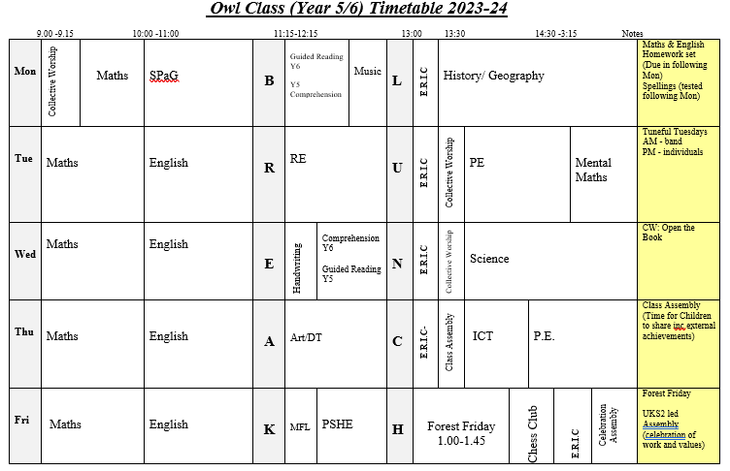
Weekly timetable for autumn term.

Slide 5
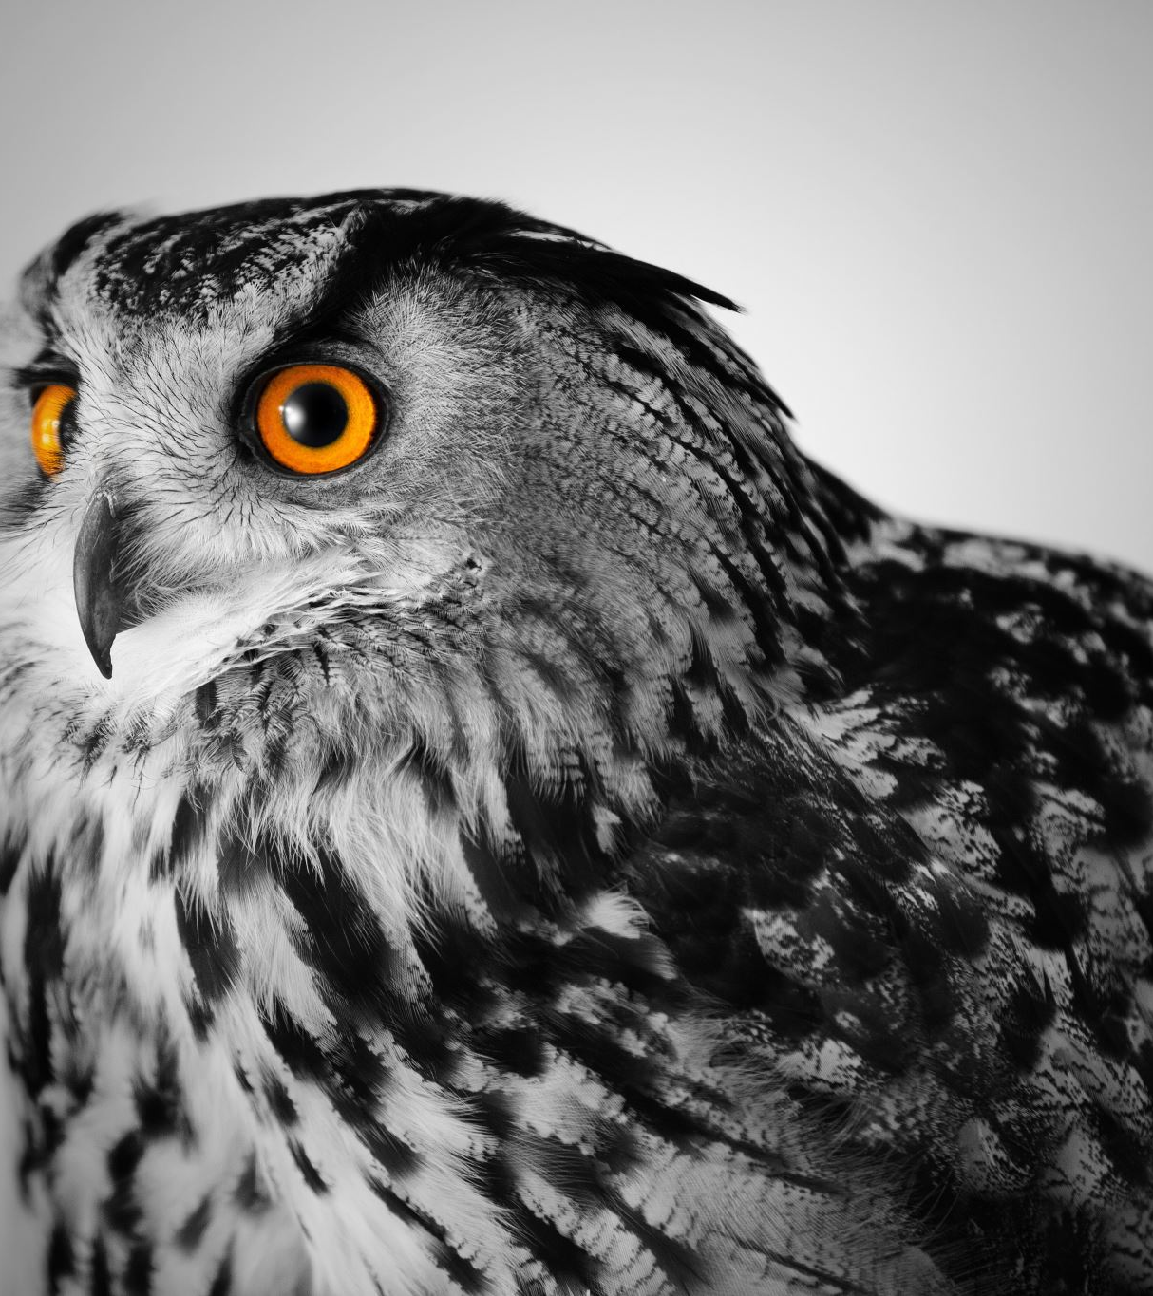
More about Owl Class-teaching and homework
Owl Class is taught by Mr Manning Monday to Friday, with support across the week from Mrs Surman and Mrs Pilley.
Homework is set each Monday and is due back the following Monday. It will include SPaG work, maths work and there will also be an independent ‘big’ task each half-term, related to our central topic.
Independent research is a vital skill for KS3. It also gives the children the opportunity to conduct and present their work in creative ways, again preparing for secondary school.

Slide 6

Our reading for pleasure programme
A love for reading one of the best gifts we can give our child, and to help foster a love for reading, we have complied a list of 40 recommended reads for each year group, which can be found on the Owl Class page. These titles are readily available at libraries and should be easily found.
Owl Class will receive an individual ‘story journal’ that is theirs to fill in how they want: sketches, collages, writing about their favourite parts, a book review or indeed any kind of record. This journal can be bought in, not to be marked, but to be shared, so the child's passion for books can be recorded and noted.

Slide 7
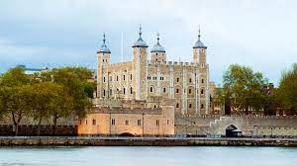
School trips for 2023/24
There is a visit planned for this week to Woodway Farm stables in Aston Rowant as part of National Racehorse Week.
Years 4, 5 & 6 will be visiting The Tower of London on Wednesday 4th October.

Slide 8
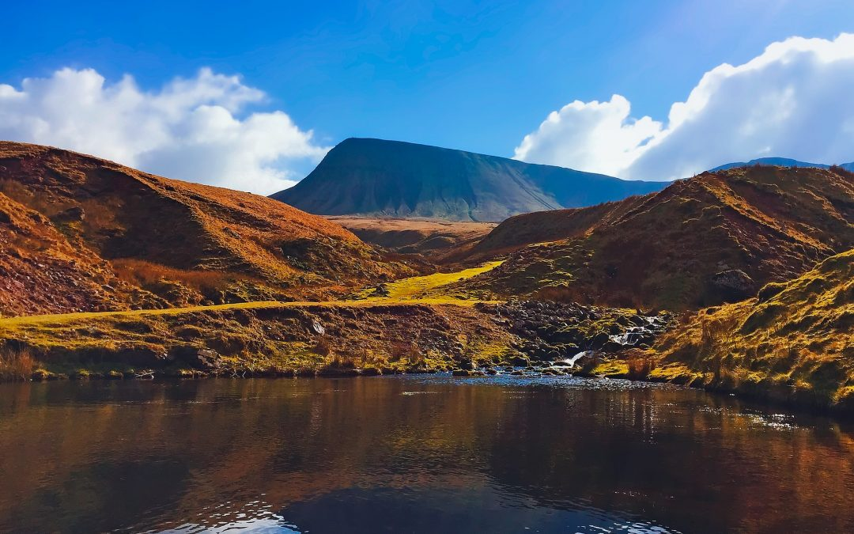
Residential Trip for 2023/24
We have a class residential trip planned in for the 3rd -7th of June, 2024, to the stunning Breacon Beacons.
The trip has been organised with Rock UK and we will be going to the Summit Centre. Activities will include orienteering; caving; abseiling; water sports etc.
There will be more details, kit-lists released shortly, and it promises to be a trip to remember!

Slide 9

SATs and assessment
This year the SATs for Year Six will begin on Monday 13th of May, and finish of Thursday the 16th May.
Monday will be the SPaG paper and spelling test.
Tuesday will be the Reading paper.
Wednesday will be the first Maths paper.
Thursday will be the last two Maths papers.
Year Six will begin practise this term with a full set of papers, so that we can take a baseline assessment.
Year Five have their own specialised revision programme and practice papers tailored to

