Slide 1


Welcome to
Fox Class
Mrs Elliott & Mrs Harper (Friday)
Mrs Pilley
Mrs Ansell

Slide 2


Slide 3


Slide 4

Our Aims:
To provide a rich learning curriculum that promotes our Christian values and provides spiritual, moral, social and cultural development for all children.
To challenge and inspire our pupils to have high aspirations and become confident, curious, independent and resilient life-long learners.
To provide pupils, as they grow in understanding, with opportunities to contribute to our school, local community and the wider world as responsible citizens.
To provide a welcoming, safe and caring environment in which everyone is valued.

Slide 5
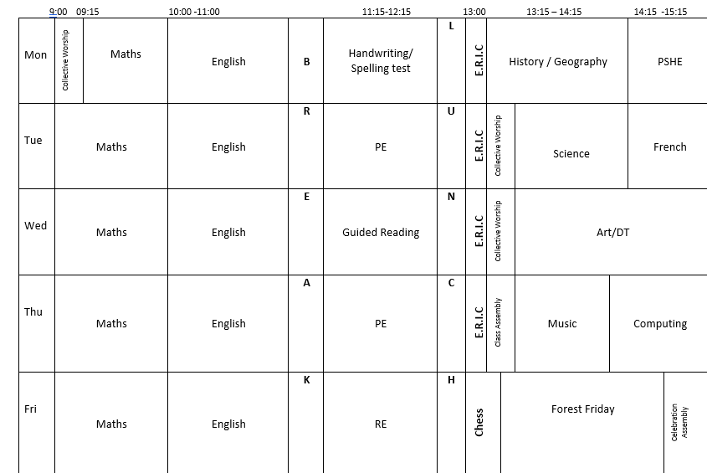
Timetable:
Lessons subject to change depending on what we’re learning.

Slide 6

Maths Lessons
Mastery Curriculum – spending more time on topics, developing fluency, reasoning and problem-solving skills
Times Table Rockstars – login details are the same.

Slide 7
Multiplication Check – Year 4 children
Takes place in June.
The purpose of the check is to determine whether your child can fluently recall their times tables up to 12, which is essential for future success in mathematics.
It is an on-screen check consisting of 25 times table questions. Your child will be able to answer 3 practice questions before taking the actual check. They will then have 6 seconds to answer each question. On average, the check should take no longer than 5 minutes to complete.

Slide 8

English Lessons
Genres are taught through creatively responding to key fiction and non-fiction texts, often linking to the topic, allowing children to simultaneously develop reading and writing skills effectively.
Spelling, Punctuation and Grammar (SPaG / GPS)
Free Writing
Handwriting sessions

Slide 9
Spelling – Home Learning
Spellings for the whole half term will be on the website shortly. These are based on the Year 3 and 4 statutory spellings and the rules will be explained in our spelling lessons.
Groups will be given.
A spelling check will be on a Monday, and children should tell you their results. I will track these and decide if additional support is needed. Please support your child in learning them and encourage where possible to use them in sentences or spot them when they are reading their books.

Slide 10
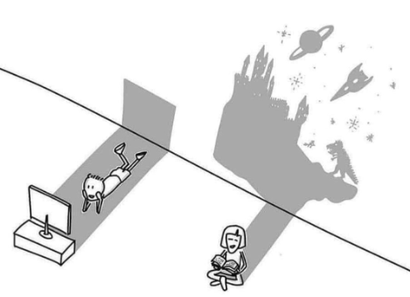
Reading – Home Learning
Every child should have a reading book in their bag daily.
Each child should be heard daily at home for up to 15 minutes. Please talk about what has been read. This enables your child to really understand what they have read.
We want children to enjoy reading and sharing books with you!
They are responsible for changing their levelled book when they have finished it. Please ensure their reading book and record comes to school every day.
I check the reading records weekly.

Slide 11
Homework
I set homework every Monday which is then due in the following Monday.
Please ensure that each book is covered in backing to ensure it stays looking great – be creative!
Each week I will set an English homework and a Maths homework. It should not take longer than 30 minutes. Any problems, then please talk to me.
We use Doodle Learning for homework, and I will set most Maths homework using this with occasional English too. The login details are in the Reading Records.
Any homework not completed will mean that your child completes them during Tuesday lunchtime.
Please talk to me if your child is struggling with homework – it is not meant to be something dreaded by them and you!

Slide 12

PE
We have two PE sessions a week: Tuesday and Thursday
Children require a full PE kit each week:-
  School PE T-shirt
  Black shorts
  Trainers (white or dark)
  Black jogging bottoms and school sweatshirt (especially for outdoor PE and during winter). We go out in MOST weathers!
  Extra socks – named if possible as I do end up with lots of odd socks!
  Long hair has to be tied back, and earrings removed or taped up. Please provide the tape.
  Please ensure all items of kit are named.

Slide 13




Snacks, water bottles and boots!
A healthy snack may be brought into school to be eaten during break time. Please ensure your child’s snack box is labelled.
A bottle of water may be kept in the classroom. Again, please ensure the water bottle is labelled.
Stationery: - please ensure you child has access to the following: a handwriting pen (not a biro), a pencil, pencil sharpener, ruler, glue stick and rubber. Colouring pencils are optional. These should be named.
Wellington boots (named) should be in school especially for Forest Friday.

Slide 14
Website
Our class page contains:
Spelling grids
Useful learning links
This presentation!

Slide 15

Any Questions?

