Slide 1


Welcome to Squirrel Class
Mrs Biggin (Teacher)
Miss Cameron (HLTA)

Slide 2

School Vision
Growing together we inspire each other to achieve our full potential as courageous lifelong learners.
'Let your roots grow down into him, and let your lives be built on him. Then your faith will grow strong in the truth you were taught, and you will overflow with thankfulness.' (Colossians 2:7)
Our vision is about growing together, developing not in isolation but learning from and with each other. It’s about inspiring learning that provides a solid foundation for the future of all stakeholders. It is about being empowered to learn without limitations. Within this we also recognise the importance of working together within the school but also utilising the valuable resources around us, including our local communities and beyond.

Slide 3
We have six core values
Gratitude
Resilience
Outreach
Wonder
Trust
Harmony
The different values are explored each half term. The values have also been linked to the Holy Trinity, which again as a Church school is key to how we explore and understand the Christian faith. The structure of the Trinity has determined the order in which we explore each value linked to it.
Our value is Wonder this half term.

Slide 4
Our Aims:
To provide a rich learning curriculum that promotes our Christian values and provides spiritual, moral, social and cultural development for all children.
To challenge and inspire our pupils to have high aspirations and become confident, curious, independent and resilient life-long learners.
To provide pupils, as they grow in understanding, with opportunities to contribute to our school, local community and the wider world as responsible citizens.
To provide a welcoming, safe and caring environment in which everyone is valued.

Slide 5
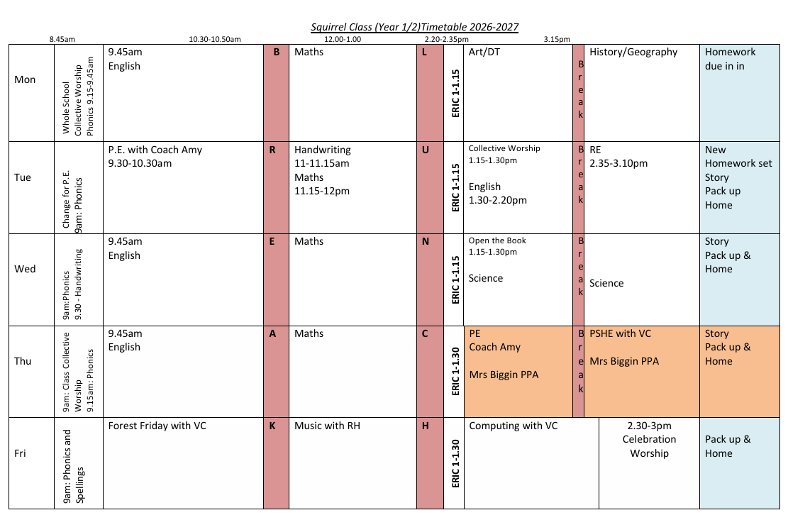
Time Table:
Lessons subject to change depending on what we’re learning or event days.

Slide 6


Maths Lessons
Mastery Curriculum – spending more time on topics, developing fluency, reasoning and problem-solving skills.
Use of concrete resources to aid understanding and engage learning. Lots of outdoor activities (weather permitting).
Challenge boxes (linked to the topic) of easy access to the children.
Catch up learning (immediate within the school day)

Slide 7
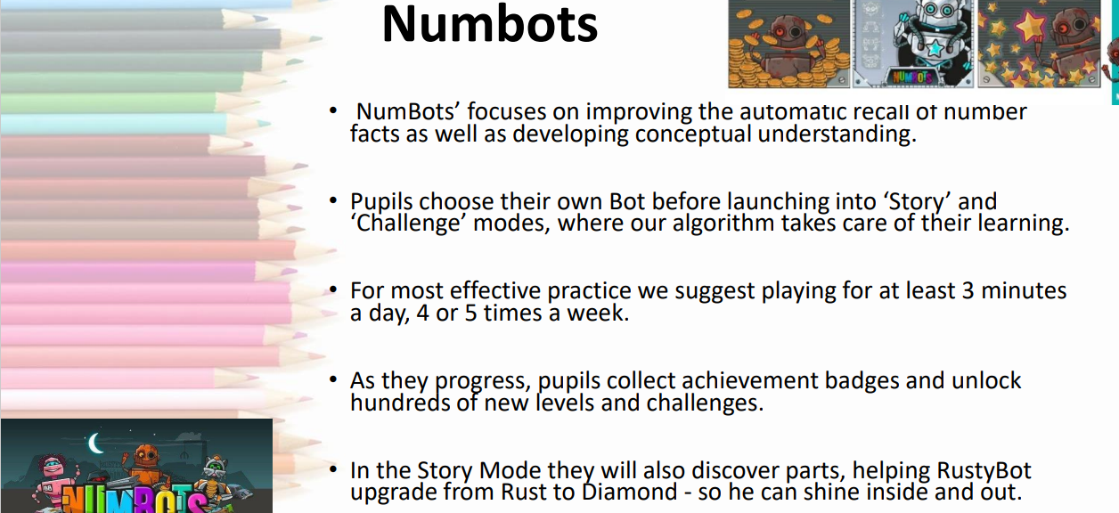
Y1 & Y2

Slide 8

TTRS –Y2
Focus on 2x, 5x and 10x (then move to 3x)
Times Tables Rock Stars is a maths programme that takes all the worry out of learning times tables and has a proven track record of boosting children’s fluency and recall in multiplication and division. Suitable for all learners aged 6 years and up, our question-based games automatically adapt to each child’s unique learning needs, helping them to recall their times tables in record speed. Accessible on any device, via the app or browser, children can play anytime, anywhere.

Slide 9

English Lessons
Genres are taught through creatively responding to key fiction and non-fiction texts, linking where possible to the topic, allowing children to simultaneously develop reading and writing skills effectively.
Spelling, Punctuation and Grammar (SPaG) lessons.
Daily Phonics sessions and 3x handwriting sessions.

Slide 10
Spellings and Homework
Spellings will be set each Tuesday, ready for a check the following Friday. These are based on sounds learned during phonics lessons and will include Year 1 and 2 statutory spellings or common exception/high frequency words. They may also include words linked to our topic.
Homework is set each Tuesday and due in the following Monday. It is usually an English/foundation subject piece to be completed in books and a Maths activity online with DoodleMaths, but may vary according to special weeks or events in school.
Please could all homework books be covered with strong wrapping or brown paper.

Slide 11

Reading
Every child should have a reading book in their bag daily and be reading for 10 mins each night.
We remind children each morning to check if they need to change their reading books and to pop them into the box for the adults to change. Ideally read a book a minimum of 2x times as rereading helps develop reading fluency, comprehension, confidence, and automatic word recognition.
We read daily as part of our English lessons but also during dedicated ERIC or guided reading sessions.
We are very lucky to have lots of wonderful volunteers who also listen to the children read over the course of the week. Each child should be heard read at least once a week.
We love to hear about what the children have been reading during our reading sessions, and will be encouraging them to read a range of genres.
We do check reading records, but they are mainly a tool for evidence of home reading. Please sign/comment 4x a week.
Please refer to the new Reading Key Milestones in the school letter dated 4th September.

Slide 12

PE
We have two PE sessions a week: Tuesday morning and Thursday afternoon. Both sessions are taught by a specialist sports coach (Coach Amy) and supported by the class TA or teacher.
Children require a full PE kit each week:-
  School PE t-shirt
  Black shorts/jogging bottoms
  Trainers (white or dark)
  Black school sweatshirt (especially for outdoor PE and during winter)
  Extra socks (soggy feet!)
  Long hair to be tied back and earrings removed/covered at home before coming to school.
  Please ensure all items of kit are named.

Slide 13




Snacks, water bottles and boots!
A snack may be brought into school to be eaten during break time. Please ensure your child’s snack box is labelled. We also supply fruit and vegetable snacks each day for the class.
A bottle of water may be kept in the classroom. Again, please ensure the water bottled is labelled. No juice please!
Stationery: please ensure you child has access to the following: a pencil and a glue stick. These will likely need topping up each half term. Colouring pencils and felt tips are optional. Pencil cases remain in bags or drawers during the school day. All items to be named.
Wellington boots (named please) should be in school, especially for Forest Friday and wet lunches. We have a covered storage box just outside the classroom.

Slide 14
Playtime and lunchtime
A morning break of 20 mins and an afternoon break of 10 mins. Friday morning break is skipping!
Staff actively monitor and supervise with free access for the children to choose equipment.
We encourage self-regulation/can you solve it yourself?
BUT…children are encouraged to always tell an adult if they are worried/upset/injured – we can’t help if we don’t know!

Slide 15
Phonics Screening– Year 1 children
Children in Year 1 take part in a phonics screening in June (week commencing 14th June 2027). Children in Year 2 will also take the check if they did not achieve the required result when in Year 1 or if they have not taken the test before.
The test contains 40 words. Each child will sit one-to-one and read each word aloud to a teacher. The test will take approximately 10 minutes per child, but is not timed and can be at the child’s pace. The list of words the children read is a combination of 20 real words and 20 pseudo words (nonsense words).
The pseudo words will be shown to your child with a picture of an alien. This provides the children with a context for the pseudo word which is independent from any existing vocabulary they may have. Pseudo words are included because they will be new to all pupils; they do not favour children with a good vocabulary knowledge or visual memory of words.
The results will be reported to you in summer term (as part of the end of year report) and will confirm if your child has met the standard threshold.

Slide 16
SATs – Year 2 children
Traditionally have taken place in the middle of May but they are now an optional form of assessment and can be taken at any point in the summer term or not at all.
A tool to further assess Maths and English alongside teacher judgement.
Two maths papers, two reading papers, two SPAG papers.
Marked and moderated by teachers within the school.
Children are assessed as:
working towards the expected standard
working at the expected standard
working at greater depth

Slide 17
School Website
Our class page contains:
Useful learning links
Updates on learning/pictures
Any enquiries or requests to be sent via the school email:
office@aston-rowant.oxon.sch.uk

Slide 18

Any Questions?

